Slide 1


Practical Coding in R for Researchers
What you will accomplish:
Learn coding basics in R 3.4.3,
a high-level, open-source programming language, using RStudio 1.1
Used for statistical computing
and graphics in academia and
professionally
11th most popular language
Easy (relatively)
A steeper learning curve than other
coding languages like Python
Strong community support
Great documentation
See what R can create
Learn practical coding tips for researchers
Get YOUR QUESTIONS answered
Notes:
1
ADD MORE MATERIAL TO LAB 1 (TOO SHORT)
Websites: Pinterest (with django), Instagram
Problem solving: Think critically and creatively, express a solution clearly and concisely

Slide 2
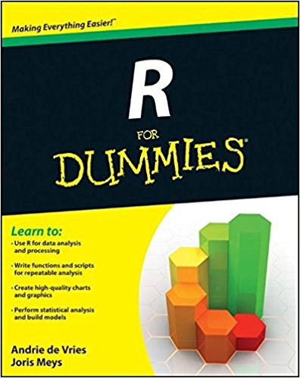
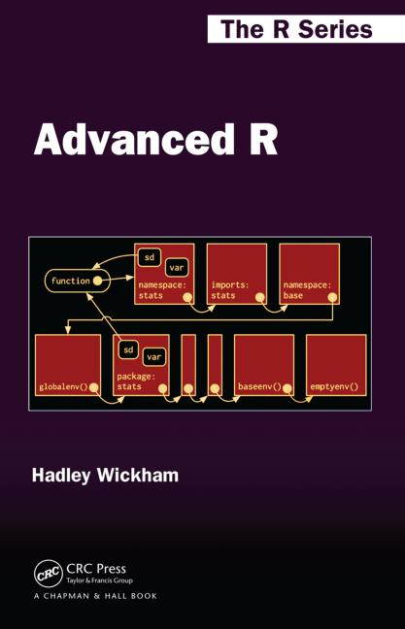




Who is in My Audience?
Do you consider yourself a beginner, intermediate or advanced programmer?
What languages do you have experience with?
Notes:
2
Formal languages: dense, concise, hard to read, strict rules about syntax
Natural languages: wordy, rely on context for understanding, redundancy, full of ambiguity
Courier New font: monospaced so that characters on neighboring lines line up in columns

Slide 3
R: The Basics
High-level Open-source Formal Interpreted
Programs or scripts
Instructions for what you want the computer to do
Stored as .R files
Read from top to bottom in sequence (mostly)
RStudio
Where we will be programming
Code directly in Console
> print(“Hello, world!”)
[1] Hello, world!
Code in Editor
Write in Editor
print(“Hello, world!”)
Place cursor or highlight lines to run
Press Crtl + Enter (Cmd + Enter) or click Run button
Code and output shown in Console
> print(“Hello, world!”)
[1] Hello, world!
Good for testing!
Use when you need to
save your work!
Notes:
3
Formal languages: dense, concise, hard to read, strict rules about syntax
Natural languages: wordy, rely on context for understanding, redundancy, full of ambiguity
Interpreted language: code written by humans is interpreted into machine code, which the processors in our computers understand
Machine code: the 0’s and 1’s that the processors in our computers understand
Courier New font: monospaced so that characters on neighboring lines line up in columns

Slide 4

Errors and Debugging
100% the most irritating, teeth-grating,
annoying part of coding!!!
Many tips and tricks to dealing with errors or debugging
Types of Errors
Syntax errors What you typed ain’t right!
> print “Hello, world!”
Error: unexpected string constant in "print
"Hello, world!"“
Type errors Apples and oranges
> “a” + 1
Error in "a" + 1 : non-numeric argument to binary operator
Logical errors That doesn’t make sense…
Code runs, but output doesn’t make sense.
Difficult to debug
Notes:
4
The term “bug” began being used with regard to computers when an error occurred in the Mark II electromechanical computer at Harvard in 1947, and a moth was found to be blocking one of its old mechanical relays. The term “bug” had been used extensively in the past to describe engineering problems; Thomas Edison even used it in 1878.
Debugging is useful in activities beyond programming.

Slide 5
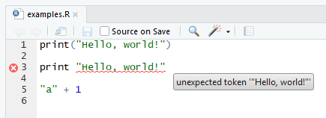
Errors and Debugging
Error Descriptions
Lots of detail
Dense but very helpful (READ THEM!)
Last error listed is “most recent”
RStudio
Highlights syntax and other errors before you run your code
Hover to see error description
Debugger
traceback(), debug(), etc.
Good tutorials on YouTube
Notes:
5
The term “bug” began being used with regard to computers when an error occurred in the Mark II electromechanical computer at Harvard in 1947, and a moth was found to be blocking one of its old mechanical relays. The term “bug” had been used extensively in the past to describe engineering problems; Thomas Edison even used it in 1878.
Debugging is useful in activities beyond programming.

Slide 6
Variables
Variables are assigned values and store them in the Environment.
> x = 7
> pet = “dog”
Make names meaningful.
Strive for understanding without #comments
counter = counter + 1
area_percent = 32.4
name_respondent1 = “Frank”
Be consistent with your naming style.
Use periods, capitals, or underscores
area.percent areaPercent area_percent
Keep names short.
num_resp1 vs. number_of_respondents_in_sample_one
Names you CANNOT use (R keywords)
Effectively no restrictions (unusual!)
OR
> x <- 7
> pet <- “dog”
SELF-DOCUMENTING CODE
Notes:
6
Self-documenting code ideal for academics that share all of their work.

Slide 7
Initializing Scripts
Clear environment
Reduces chances of logical errors from previous runs
rm(list = ls())
Clear Console
Clears text in Console from previous runs
cat(“\014”)
Clear files from output folder.
Useful when you save text/graphics to files via code
file.remove(dir(paste(getwd(), “/output/”, sep = “”),
full.names = TRUE))
Load custom functions
Save your custom functions in a separate R file for easy importing into different scripts
source(“functions.R”)
Load libraries
Use my load_libraries function on GitHub to easily install and load the libraries your script needs
load_libraries(c(“name.lib1”, “name.lib2”, …))
Notes:
7

Slide 8
Importing Data
Specify file to import using string variable
Makes future changes to code easier
file.to.import = paste(getwd(),
“/data/data_oct2017.xlsx”,
sep = “”)
Use rio library to import data from file
Streamlined data import and export
Makes assumptions based on data file type “that the user is probably willing to make”
Excel, .csv, SAS, SPSS, Stata, JSON, etc.
load_libraries(“rio”)
data = import(file.to.import)
- Loads info from file into the variable data
as a dataframe, R’s fancy data structure type
→ LOTS of useful functionality
Notes:
8

Slide 9
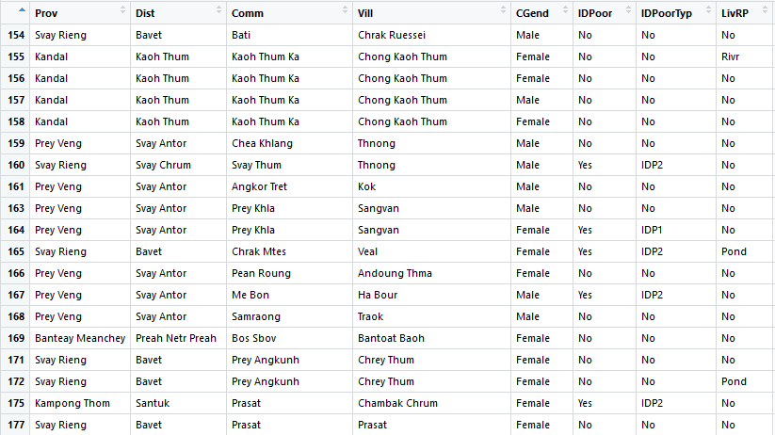
Cleaning Data
The columns and rows of the variable data
Notes:
9

Slide 10
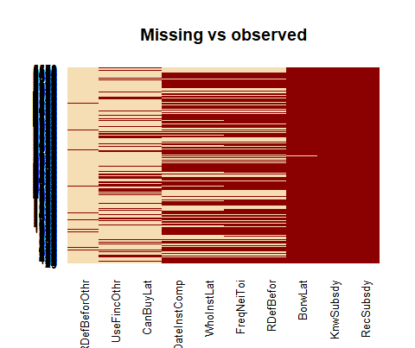
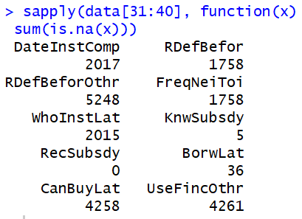
Cleaning Data
Visualize missing data
load_libraries(“Amelia”)
missmap(data, main = "Missing vs observed",
legend = F)
sapply(data, function(x) sum(is.na(x)))
Notes:
10

Slide 11
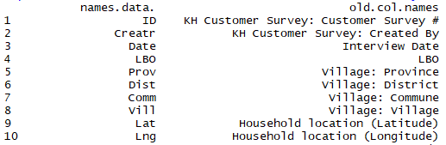
Cleaning Data
Change names of columns in dataframe
Easier to understand, access, and display in Console and graphics
Steps
Save original columns names
old.col.names = names(data)
Change column names
names(data) = c(“ID”, “Date”, “Name”, …)
Must have the same number of names as columns
in data
Verify consistency
print(data.frame(names(data), old.col.names))
Notes:
11

Slide 12
Cleaning Data
Remove unused columns
cols.to.drop = c(“Creator”, “Lat”, “Lng”, …)
data = data[, !(names(data) %in% cols.to.drop)]
OR
data = subset(data, select = -c(Creator, Lat,…))
Convert data types
data$Date = as.Date(data$Date)
data$Vill = as.factor(data$Vill)
for (i in 1:length(names(data))) {
if (is.character(data[i][[1]])) {
data[i][[1]] = as.factor(data[i][[1]])
}
}
Create new columns based on existing columns
data$Yr = as.factor(format(as.Date(data$Date,
format = “%Y-%m-%d”),“%Y”))
Notes:
12

Slide 13
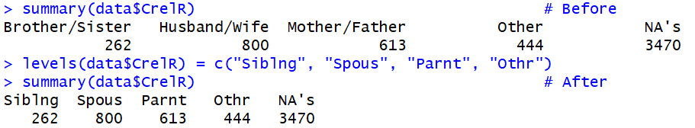
Cleaning Data
Rename factors (levels) within a column
Must have same number and be in order
Always check using summary() before and after for consistency!
summary(data$CrelR) # Before
levels(data$CrelR) = c("Siblng", "Spous",
"Parnt", "Othr")
summary(data$CrelR) # After
Notes:
13

Slide 14
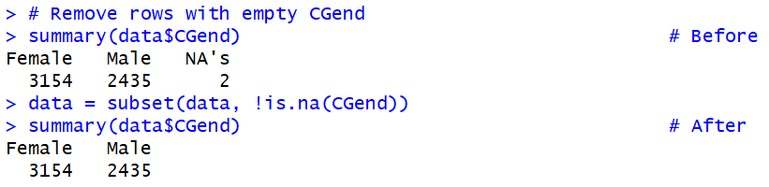
Cleaning Data
Remove rows that have a certain variable missing
summary(data$CGend) # Before
data = subset(data, !is.na(CGend))
summary(data$CGend) # After
Keep only rows that pass a logic test
data = subset(data, Prov != “Phnom Penh”)
data = droplevels(data)
Notes:
14

Slide 15
Cleaning Data
Create new column based on existing column using logic
e.g., if Behav equals “Wave”, then make Behav_Wave equal 1.
summary(data$Behav) # Before
data$Behav_Wave =
ifelse(is.na(data$Behav),
NA,
ifelse(grepl(“Wave”, data$Behav,
fixed = TRUE),
1,
0))
data$Behav_Wave = as.factor(data$Behav_Wave)
summary(data$Behav_Wave) # After
Notes:
15

Slide 16
Cleaning Data
Combine columns using logic
e.g., if Poor equals “No” and PovertyCategory equals NA, then copy Poor to PovertyCategory
print(data.frame(data$Poor, # Before
data$PoveryCategory))
for (row in 1:length(data$Poor)) {
if (data[row,]$Poor == “No” &
is.na(data[row,]$PovertyCategory)) {
data[row,]$PovertyCategory = data[row,]$Poor
}
}
print(data.frame(data$Poor, # After
data$PoveryCategory)) summary(data$PovertyCategory) # After
Notes:
16

Slide 17
Analyzing Data
Useful functions
summary(), names(), subset(), order(), unique(), data.frame(), print(), paste(), round(), rep(), …
Useful libraries
FactoMineR, vcd, factoextra, ltm
Frequency analyses
Lots of libraries and functions out there
e.g., table(), prop.table(), CrossTable()
I created 1-way, 2-way and 3-way frequency-analyses functions (GitHub) to streamline my analyses.
Include association metrics like chi-squared
Generalized linear modeling with glm()
Create linear models to predict outcomes using inputs of any type (categorical, ordinal, interval, ratio)
Examples on GitHub
Notes:
17

Slide 18
Analyzing Data
Statistical analyses
Everything you want to do, R can do.
Lots of good libraries and functions out there
Here are some basics:
summary(results)
- Can tell you a lot depending on how results was created (e.g., output from glm())
anova(results, test = “Chisq”)
mean(), median(), sd(), …
Check out Quick-R’s and DataCamp’s tutorials for statistics in R
Notes:
18

Slide 19
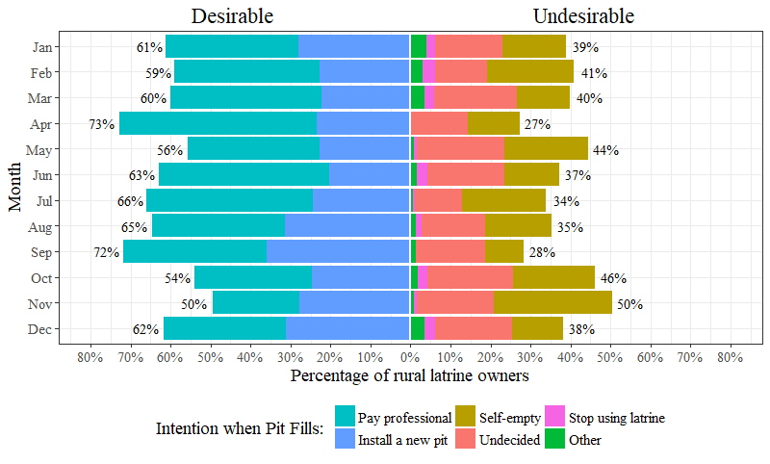
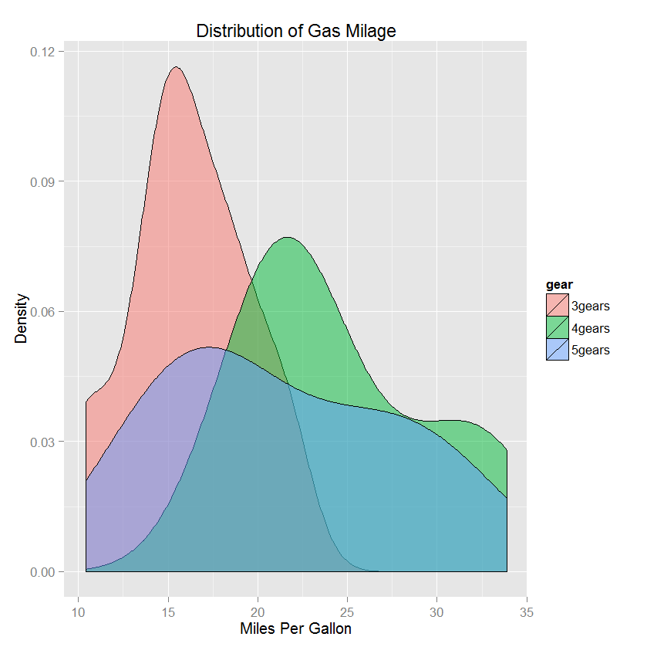
Plotting Results
Useful plotting functions
plot(), barplot() (built into R)
corrplot() from library corrplot
qplot() and ggplot() from library ggplot2
Lots of other functions and libraries out there
Check out Quick-R’s tutorial and suggestions
Notes:
19

Slide 20
Export Results
Save text sent to Console to text file instead
Text will not show up in Console!
file1 = file(paste(getwd(), “/output/results.txt”,
sep = “”))
sink(file1, append = TRUE)
sink(file1, append = TRUE, type = “message”)
Stop saving Console text to file
sink()
sink(type = “message”)
Notes:
20

Slide 21
Export Results
Save plots to PDF file
pdf(paste(getwd(), “/output/results.pdf”,
sep = “”))
Stop saving plots to PDF file
dev.off()
closeAllConnections()
Could also use ggexport() from ggpubr library
plot1 = plot(x, y)
plot2 = plot(y, z)
load_libraries(“ggpubr”)
ggexport(plotlist = list(plot1, plot2),
filename = paste(getwd(),
“/output/results.pdf”,
sep = “”))
Notes:
21

Slide 22
Sharing Results
Shiny app
Notes:
22

Slide 23
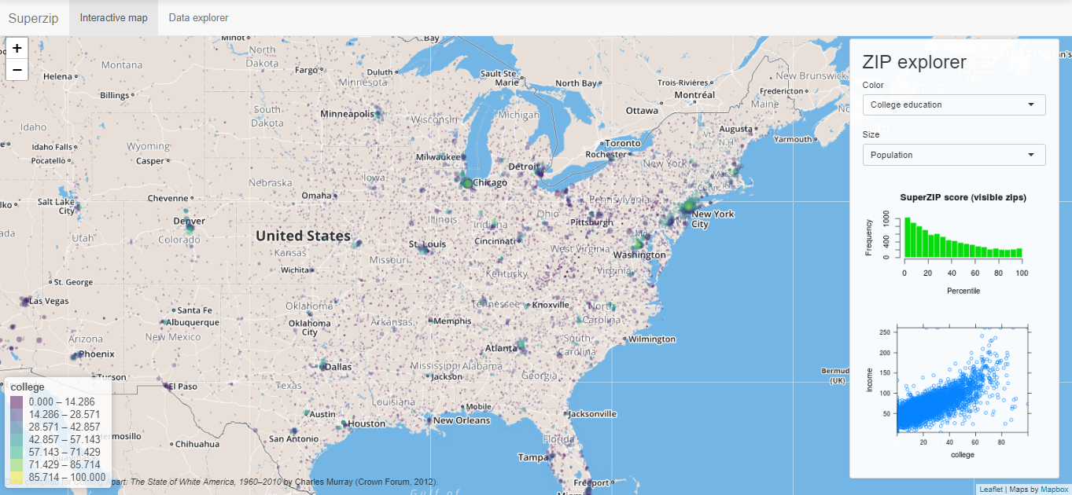
Sharing Results
SuperZip map from Shiny Gallery
Notes:
23

Slide 24
Ending Your Script
Coding can get complex quickly, especially when debugging.
When saving text/plots to files, problems can arise when errors occur.
If you save text/plots to files anywhere in your code, add the following to the end of your script.
sink()
dev.off()
closeAllConnections()
Ensures all outputs go to Console and RStudio’s plot window instead of to files when you run your next script
Saves time and reduces headaches
Notes:
24

Slide 25
Useful References
Learning R is tough. Check these out!
R Documentation
Great info on all built-in functions, types, modules, third-party guides, etc.
R for Data Science book
The online version of a book written by Hadley Wickham, Chief Scientist at RStudio and a Professor of Statistics
RStudio Online Learning
Tutorials, articles, and examples from RStudio
DataCamp, RBloggers, Quick-R, and Advanced R
Search Google for your specific problem!
Ask your resident R nerd.
Notes:
25

Slide 26
Summary
Read those error descriptions!
Write self-documenting code.
For your and others benefit
Even your own code is hard to understand even just a month later!
Get familiar with how to clean your data effectively and efficiently.
Makes analysis easier
Shows other researchers what you did (reproducibility!)
Learn about analyses and plotting functions that suit your needs via R’s online community and documentation
Check out my GitHub for useful functions
Ask me questions anytime!
We learn when presented by challenges.
Notes:
26
Websites: Pinterest (with django), Instagram
Problem solving: Think critically and creatively, express a solution clearly and concisely

Slide 27
Workshop
Let’s answer questions
you have about…
Your own work
What I presented
Notes:
27
Websites: Pinterest (with django), Instagram
Problem solving: Think critically and creatively, express a solution clearly and concisely

Slide 28
My Contact Information
James Harper, PE, ENV SP
james.harper@colorado.edu
(858) 522-9249
Example R files and this presentation
available on GitHub
Notes:
28
Websites: Pinterest (with django), Instagram
Problem solving: Think critically and creatively, express a solution clearly and concisely

